Slide 1

AMERICAN INTERNATIONL UNIVERSITY BANGLADEH
PROJECT TITLE: FARMING ASSISTANT
Done By:
Group 10
Section: O
Instructed By:
Honorable MD. NAZMUL HOSSAIN Sir

Slide 2
FARMING ASSISTANT
Farm Assistants are new entrants and generally work under full supervision. Farm assistants work closely with a Farmer and Agriculturists.

Slide 3
GROUP INFORMATION
Group number 10
Group Member Details :
Serial | ID | Name
19 | 19-40183-1 | KHAN, MD RIAZ
20 | 19-40211-1 | Jony, Md. Shaheen Alam
31 | 19-40789-2 | SHAHADAT, NAFISA BINTE
40 | 19-41557-3 | BANIK, THITHY
41 | 19-41628-3 | HOSSAIN, SHAHRIER

Slide 4
Project Object/Motivation
In this project we mainly try to give more facilities of the farmers in rural areas. Farmers are always under privileged in our country. In many times they don’t get help when they need it. Also, there is a huge party between the farmers and the buyers. At last farmers are deprived of their proper rate of market price and on the other hand we, the buyers buy in overrated price. It’s a huge imbalance in economy. In this project, we are trying to make such a software which can be used by farmers as well as the buyers So, both clients can see each other’s status. Also sometimes farmers need some instruments or equipment. But they can’t get these because of transport problems or the shortage of the needs. At present time, there are many modern technology and digital ways of farming. Everyday agricultural researchers discover new things about farming. Farmers are unknown about these discovers. So, in this application farmers can find these things and improve their cultivation skills. Also agriculturist can provide their experimental skills to solve a farmers problems. We’ll try to solve these problems in this project.

Slide 5
PROJECT DETAILS
‘Farming Assistant’ project is divided into two parts.
Users
Functionalities

Slide 6
User
In this project there are two type of users :
Agriculturists
Farmers

Slide 7
USER
1.Agriculturists
In this project, only certified Agriculturist can register. They can post blogs . They can get help from an admin, can edit posts and communicate with clients, provide them the best suggestions for farming.

Slide 8
USER
2.Farmers
Farmers can create account. If they face any problem in cultivation they can find the solution in the software. There problem’s solution is given in the software with picture. They can sell any product Just a simple post with a satisfied price. Also they can buy their necessary products with a limited price.

Slide 9
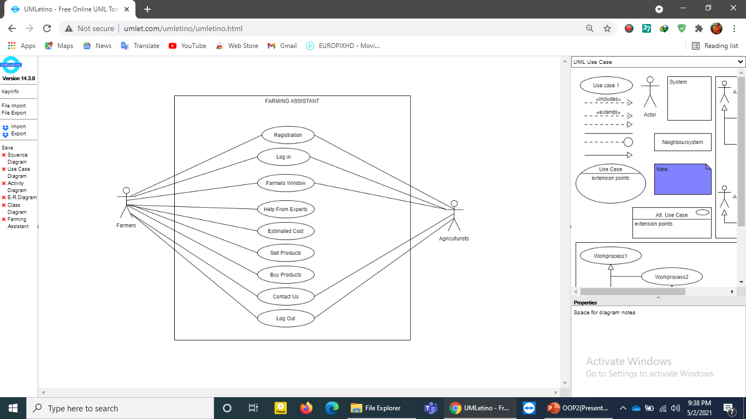
FUNCTIONALITIES
Use Case Diagram of the Functionalities

Slide 10
FUNCTIONALITIES
Common Functionalities for all users:
All users can register to the system.
All users can Login to the system
Can manipulate their profile information (edit-delete-view etc.)

Slide 11
FUNCTIONALITIES
REGISTRATION
Users can create an account by register to the software.
For register users have to provide Names, Phone no, Gender, Username and password.
LOGIN:
After creating the account users login to the system by providing correct username and password.

Slide 12
FUNCTIONALITIES
Farmers Windows
In this function, farmers can get their problems solutions.
At first farmers can see many crops name. They can select any of the crop which they have faced problems.
Second stage farmers can select exactly which type of problem the have faced of the particular crops.
After selecting the problem, farmers will get their solution.
Also expert agriculturists post their latest research solutions in this section.
Agriculturists give most easiest solution so that farmers can get it quickly and apply this at a limited cost.

Slide 13
FUNCTIONALITIES
Get Help From Expert:
In this section farmer can post their problems.
They can add a title which describe the problem name.
Describe which crop and it affected.
Upload a photo of the affected crop.
And submit it. This post can be shown by the expert agriculturists and farmers get a solution there.

Slide 14
FUNCTIONALITIES
Estimated Cost:
Farmers can get help from this function.
They can know at which season, which crops contain how much amount of cost.
By doing this calculation, they can easily find the total cost of a particular crop before cultivating the crops.

Slide 15
FUNCTIONALITIES
SELL PRODUCTS
Farmers can sell product in this software.
Farmers have to provide Product name, a Unique id, Price and image of the product.
BUY PRODUCTS:
Farmers also buy their necessary products by using this software.
If they want to buy something, they provide products name, unique id, price(which they expect), sample image of the product.
They can add product as many they want.
At last they have to choose a payment option and place the order .

Slide 16
FUNCTIONALITIES
Contact Us:
Both farmers and agriculturists can contact with admins about any update or any feature that would help the users.
Log Out:
Users log out the system.

Slide 17
DRAWBACKS OF THE PROJECTS
Less Functionalities:
Some more functionalities can be used in this project to make it more convenient.
Contact with Agriculturists. This function can be used by farmers and they can contact with agriculturists with a video conference.
A new functionalities can be add which makes a connection between farmers and the general public in country.
General people can be a user of this project.

Slide 18
UPDATED VERSION
In Future we continue updated the software so that users can get more better version day by day.
Users will be increased in this software.
More functionalities will be added.
More easy communication for the users.
Delivery company will be increased so that farmers can get their necessaries more easily.

Slide 19
Contribution
Md. Shaheen Alam jony did 30% in this project.
Md.Sharier Hossian did 20% in this project.
Nafisa Binte Shahadat did 20% in this project.
Md.Riaz Khan did 15% in this project.
Thithy Banik did 15% in this project.

Slide 20
THANK YOU

